Slide 1
Terrain Collision Detection
IN628 Intermediate Architectures and Algorithms
Semester 2, 2016
Session 7.2

Slide 2
Types of Collision Detection
Sprite to Sprite Collision
Sprites checking for collisions with other sprites.
Sprite to Terrain Collision
Moving sprites (e.g. player characters, NPCs) checking for collisions with objects in the tile map.
Notes:
We looked at the first one last time.
Now we’ll do the second one. This is the logic that gives the world some relevance as different kinds of tiles begin to have different properties.

Slide 3
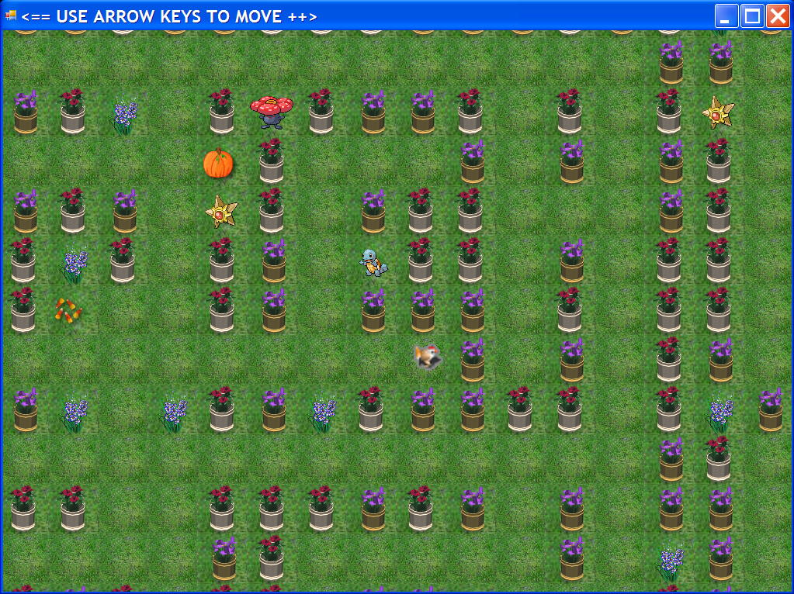
Terrain Collision Detection
Notes:
See the chicken? She is the player character.
In this game she is in a maze – the grass tiles are the ground and the flower pots and other objects are barriers. That is, she can’t walk through them.
If you walk the chicken up to a barrier, she stops, even if you keep pressing the arrow key.
To implement this, we use (or add and use) the Tile class’s “isWalkable” property.
Grass tiles have isWalkable = true; all others have isWalkable = false.

Slide 4
Algorithm
When the sprite moves:
Determine what tile the sprite will move onto
Determine if that tile is walkable
If so, move the sprite. If not, don’t move the sprite.
Notes:
So we use a priori collision detection.
There are two complexities here.

Slide 5
Problems
Figuring out which tile the sprite will move onto.
Figuring out if it is walkable.

Slide 6


Which Tile?
xTile = xPos / TILE_SIDE
yTile = yPos / TILE_SIDE
(xPos, yPos)
Collision point
Notes:
As always, we can start with this, but it’s not very accurate.
Look at the illustration…
The obvious collision point is at the chicken’s feet (or in slightly if you’re proportionally reducing the bounding rectangle).
You want the chicken to stop when its lower right corner hits the flower tile.
But xPos yPos is the upper left corner. If you compute xPos/Tile_SIDE, you get the tile that the upper left corner is in, not the tile the lower right corner is in.
So what should you do? => compute the pixel coordinate of the collision point by adding framewidth and frameHeight to xPos and yPos as required.
Use that point to compute the tile the player is about to move onto.
Note thought that the correct point to look at depends on what direction the sprite is moving...

Slide 7




Which Tile?
North
East
South
West
If the SpriteDirection is... | Look at this corner
North | Upper left
East | Lower right
South | Lower left
West | Lower Left
Notes:
You might need to modify this depending on your sprite’s image, if it has a clear leading part.
You might want to make it more accurate by looking not at the corner, but at the centre in cases like North and South where there is a nose.

Slide 8
How to Get a Tile’s isWalkable?
Sprite ? Tile
Notes:
The sprite class needs to know whether it can move
The tile class holds the isWalkable information
How can a sprite get information from a tile?

Slide 9
How to Get a Tile’s isWalkable?
Sprite ↔ TileMap ↔ TileList ↔ Tile
Therefore the Sprite class must now hold a pointer to its TileMap.
col, row
index
get or property
isWalkable
isWalkable
isWalkable
Notes:
Another OO data chain.
The sprite computes its tile column and row and calls a TileMap method, passing them in. That method should return true or false, depending on the isWalkable to the target Tile.
In that method, the tile map figures out what tile index is at that location in the map and calls a method of the TileList, passing the index in. that method should return the isWalkable, so the TileMap can return it to the Sprite.
In the TileList’s method, the tile list figures out which tile corresponds to the index and asks for its isWalkable value.
Each method must return the data it gets to the caller until the value works its way back up to the Sprite.
So you pass the Sprite’s data down the chain and the Tile’s data back up.
This is a very common OO pattern.
So you must give your sprite a pointer to its tilemap on creation. If you change TileMaps, update this pointer.

Slide 10
Change to the Engine
Add a TileMap^ class data member to class Sprite, (passed into the constructor).
Add appropriate method(s) to the Sprite class to compute what tile column and row it is going to step onto if it moves.
Add appropriate methods to Tile, TileList and TileMap to support step 2.
Adjust Sprite::Move so that xPos and yPos are only changed if the new Tile turns out to be walkable.
Notes:
Think about the logic of step 4. You must compute the new xPos and yPos and place them into local variables.
Do the newTileColumn and newTileRow computations based on these variables
Determine if the new tile is walkable.
Only if it is, copy the temporary values into into the real xPos and yPos

Slide 11
Logic for a priori movement
Determine what the next xPos and yPos would be, and store these values in local variables (e.g. nextXPos and nextYPos).
Determine what Tile nextXPos and nextYPos would land on.
Determine whether that Tile is walkable.
Only if it is, copy nextXPos into the real xPos and nextYPos into the real yPos.
Notes:
How do you compute the temp positions? => just like you always do: nextXPos = xPos + veldir[Spritedir] * xVel.
Watch your modularity here. Don’t just dump everything inline in the move method. Remember: if you can describe it with a single verb, it’s probably a method.

Slide 12
Deliverable
Build a world with a player character who doesn’t walk through the walls.
Images and small and large map files on the I: drive (or make your own).
Optional extension: Include pickup sprites and use your sprite to sprite collision detection as well.

